Slide 1

Logical Thinking Process and Problem Identification
Research Methodology and Scientific Writing
Faculty of Computer Science
University of Indonesia

Slide 2
Session Objectives
To understand logical reasoning using inductive and deductive approaches
To understand how to build “argument”
To understand how to analyze and interpret “argument”
To understand how to draw conclusion using logical reasoning
To be able to identify specific research problems.
To be able to construct hypothesis or research questions.
To be able to determine research objectives.

Slide 3
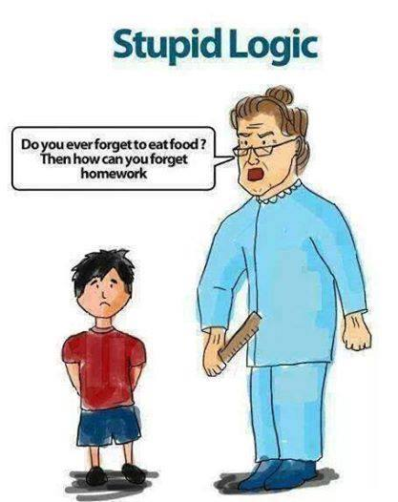
Apa yang salah dari percakapan di atas?
Apa yang betul dari percakapan di atas?
http://www.indianfunnyimages.com/

Slide 4
Why We Need Logical Thinking?
To form and evaluate our “believe” on a statement.
To determined logically an objectively whether a statement is valid or not.
To draw a conclusion from a logical thinking process.
Logical thinking consists of input, process, and output.

Slide 5
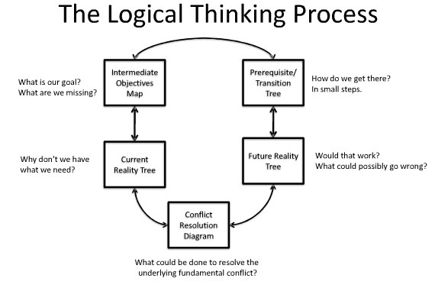
1
2
3
5
4
Source: Rotnetix.com

Slide 6
Definition of Logic
Logika (logic) merupakan suatu studi tentang metode-metode dan prinsip-prinsip yang digunakan dalam membedakan penalaran (reasoning) yang tepat dari penalaran yang tidak tepat [Hayon, Y.P., 2000].
Penalaran (reasoning, jalan pikiran) adalah suatu proses berpikir yang berusaha menghubung-hubungkan fakta-fakta atau evidansi-evidansi yang diketahui menuju kepada suatu kesimpulan [Keraf, Gorys, 1994].

Slide 7
Elements of Logic
Dalam logika terdapat beberapa elemen yang terkait seperti:
Argumen (argument): argumentasi/alasan
Premis-premis (premises): dasar pemikiran yang benar
Proposisi (propositions): pernyataan yang memiliki arti penuh/utuh
Inference: ide/gagasan
dan Conclusion: kesimpulan
Implikasi lainnya adalah kita dapat mulai dari premis yang salah, memprosesnya melalui inference yang valid dan menuju pada kesimpulan yang benar.

Slide 8
Argument
Logic is the study of argument
“a reason or set of reasons given with the aim of persuading others that an action or idea is right or wrong”. (logic.webcrawler.com/)
Example of a non-debatable argument: “Pollution is bad for the environment”
Example of a debatable argument: “At least 25 percent of the government budget should be spent on limiting pollution”

Slide 9
Contoh Premise
“Identical twins often have different IQ test scores. Yet such twins inherit the same genes. So environment must play some part in determining IQ”.
The argument consists of three statements:
Identical twins often have different IQ scores. [premis]
Identical twins inherit the same genes. [premis[
So, environment must play some part in determining IQ. [kesimpulan]
The first two statements in this argument give reasons for accepting the third. In logic terms, they are said to be premises of the argument, and the third statement is called the argument's conclusion."

Slide 10
Schematic Form of a Simple Inductive Argument
Inductive argument consists of premises and conclusion
Premise can be found through observation (data gathering an analysis)
Structure of argument:
First Premise
Second Premise
n… Premise
Conclusion

Slide 11
Contoh Logika Induktif
Apel 1 keras, warnanya hijau, dan rasanya masam
Apel 2 keras, warnanya hijau, dan rasanya masam
Apel 3 keras, warnanya hijau, dan rasanya masam
_______________________________________
Kesimpulannya: Semua apel keras, warnanya hijau, dan rasanya masam
“Bisa jadi, kesimpulan ini salah karena sample yang diambil tidak representatif?”
Hati-2 dalam memilih sample, bisa mengarah ke manipulasi data,
misalnya, dalam pooling pendapat (pilkada, merek dagang, dll)

Slide 12
Logika Deduktif
Penalaran deduktif berdasarkan pengetahuan sebelumnya yang bersifat umum, dan menyimpulkan pengetahuan baru yang bersifat khusus.
Bersifat silogisme: argumen yang terdiri dari premis-premis dan kesimpulan.
Hubungan antara premis-premis dengan kesimpulan merupakan hubungan yang tidak terpisahkan satu sama lain.
Intinya terletak pada tepat tidaknya “hubungan” antara premis-2 dengan kesimpulan.
Bersifat a priori: premis-premis tidak memerlukan pengamatan inderawi atau empiris

Slide 13
Contoh Logika Deduktif
Semua manusia berakal budi
Cecep adalah manusia
_____________________________
Kesimpulan: Cecep berakal budi

Slide 14
Logical Fallacies
Logical fallacies, Logical errors in scientific writings.
Logic is the set of rules by which one can formulate convincing arguments
It is "the science of argument."
When presenting an argument, one takes a set of premises that are proven to be true and uses logic to show how they prove a certain “c.“
If an argument contains a fallacy, then the conclusion will not necessarily be proven.

Slide 15
General Categories of Fallacies
Material fallacies
Stealing is a crime. Stealing is a part of baseball. Therefore, baseball is a criminal activity.
Fallacies of relevance
someone who tries to prove a point using emotion, or who proves the wrong point
Verbal fallacies (fallacies of ambiguity)
The loss made Jones mad [= angry]
Notes:
Material fallacies:
Stealing is a crime. Stealing is a part of baseball. Therefore baseball is a criminal activity.
Fallacies of relevance:
someone who tries to prove a point using emotion, or who proves the wrong point, commits a fallacy of relevance
Verbal fallacies:
An argument which contains "improper or ambiguous use of words" is invalid

Slide 16
Research Overview
Penelitian biasanya dilakukan untuk menjawab pertanyaan yang belum dapat terjawab, baik dari seorang peneliti sebelumnya, permasalahan yang muncul sehari-hari, atau adanya suatu opportunity (kesempatan).
Untuk melihat dengan jelas tujuan dan sasaran penelitian, maka perlu dilakukan identifikasi masalah.
Dalam memilih masalah penelitian, perlu dipertimbangan beberapa hal (feasibility), antara lain: ketersediaan waktu, biaya, kemampuan si peneliti maupun kontribusi yang akan diberikan oleh penelitian tersebut bagi pengembangan ilmu pengetahuan dan teknologi.

Slide 17
What are the questions to identify problems?
Problem Formulation
Is there any problem encounter so far?
What is the impact of the problem?
Who involve in that problem? Etc.
Identification Research Problem
To what extend the problem may disrupt
further activities?
Given the constraints, is the scope manageable?
Identification Scope of Research
Identification Research Questions
What are the factors causing the problems?
How these factors interrelated?
To what extend these factors influence the
performance?
Identification Research Objectives
Is there any significance impact if the problems
solved?
What are the benefits of the research?

Slide 18
Hypothesis
Basically, there are to types of hypotheses:
Hypothetical statement
Statistical hypothesis
Hypothetical statement does not use statistical analysis
Apakah IT dapat meningkatkan kinerja perusahaan?
Seberapa efisien suatu algoritma dapat menyelesaikan suatu masalah?
Biasanya menggunakan pendekatan kualitatif
Statistical hypothesis uses statistical analysis.
Menggunakan pendekatan kuantitatif.
Seberapa besar pengaruh penggunaan IT terhadap peningkatan kinerja organisasi? (perbandingan sebelum dan sesudah menggunakan IT)

Slide 19
Determine Research Objectives
Make sure you have a strong reason why such research is worth of doing
Study the impact?
Study the usage?
Study the efficiency?
Research objective should reflect the solution of the problem
If you can not state the problem, you can not state the objective
Build your reasons based on facts (previous studies, existing problems, etc.)

Slide 20
Q/A
Write several general problems related to CS, IS and IT.
Build argument why such general problems are worth to research.
Express your experience in stating hypothesis
Hypothetical statement
Statistical hypothesis

